Slide 1


Individual-based modelling in RangeShiftR
Damaris Zurell, Anne Malchow
https://damariszurell.github.io
@ZurellLab
Pictures from www.undekade-biologischevielfalt.de
Notes:
1
<number>

Slide 2
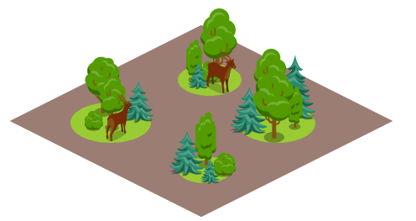
Spatially explicit population models
Local population dynamics described by population model, e.g. logistic growth or matrix population model
Dispersal described by dispersal kernel or movement simulator

Slide 3
Spatially explicit population models
Local population dynamics described by population model, e.g. logistic growth or matrix population model
Dispersal described by dispersal kernel or movement simulator

Slide 4
RangeShiftR – local population dynamics
Stage-structured population:
Life cycle can be described by subsequential developmental stages
Rates are defined w.r.t. to a fixed-length time step (usually 1 year)
Notes:
2
<number>

Slide 5
RangeShiftR – local population dynamics
Stage-structured population:
Life cycle can be described by subsequential developmental stages
Rates are defined w.r.t. to a fixed-length time step (usually 1 year)
Example:
Stages:
Juveniles - do not reproduce
Sub-adults - inexperienced breeders
Mature adults - experience breeders
Transition rates:
F_{i,1} Fecundity
S_{i,j} Development rate
(transition to next stage)
S_{i,i} Survival probability
Life-cycle graph
With (2019) Oxford Univ. Press.
Notes:
2
<number>

Slide 6
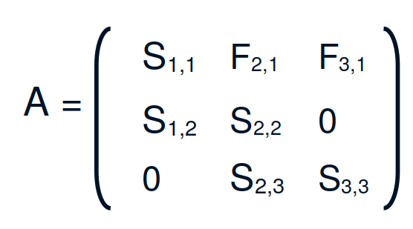
RangeShiftR – local population dynamics
Parameters provided through classical transition matrices (but applied stochastically)
Transition matrices can be age-structured (Leslie matrix) or stage-structured (Lefkovitch matrix)
Life-cycle graph:
(Lefkovitch) Transition matrix:
Fecundity
Survival
Development
With (2019) Oxford Univ. Press.
Notes:
2
<number>

Slide 7
RangeShiftR – local population dynamics
Parameters provided through classical transition matrices (but applied stochastically)
Transition matrices can be age-structured (Leslie matrix) or stage-structured (Lefkovitch matrix)
Life-cycle graph:
Lynx transition matrix:
Fecundity
0 0 5.0
0.53 0 0
0 0.63 0.8
A_{Lynx} =
Survival
Development
With (2019) Oxford Univ. Press.
Notes:
2
<number>

Slide 8
RangeShiftR – local population dynamics
In RangeShifter, the processes of reproduction and survival / development happen subsequentially
Notes:
2
<number>

Slide 9
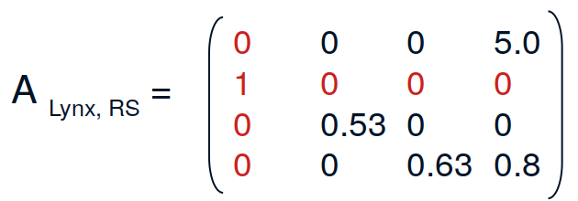
RangeShiftR – local population dynamics
In RangeShifter, the processes of reproduction and survival / development happen subsequentially
→ introduce “stage 0”
(for individuals that develop to stage 1 in the same year they are born)
Notes:
2
<number>

Slide 10
Cell-based vs. patch-based models

Slide 11
Spatially explicit population models
Local population dynamics described by population model, e.g. logistic growth or matrix population model
Dispersal described by dispersal kernel or movement simulator

Slide 12
Dispersal
Natal/juvenile dispersal: spatial process by which individuals move away from birth location
avoid kin competition, exploit new resources
Critical for range expansion and spatial gene flow
Associated with various costs and trade-offs that determine the eventual displacement distance
has impacts on both population dynamics and genetics

Slide 13
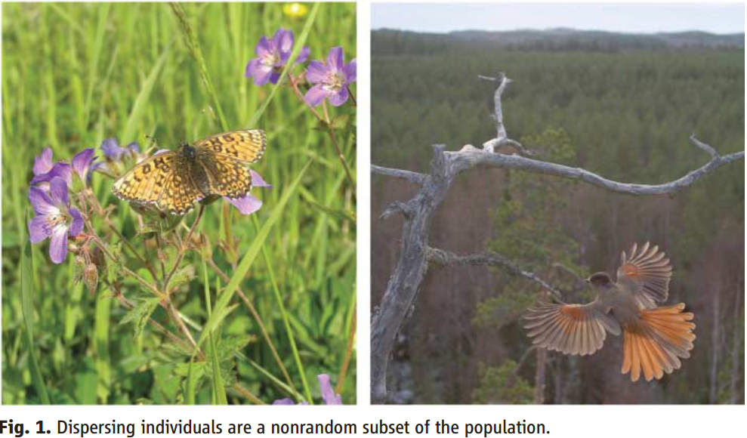
Dispersing individuals are a special subset of the population
(Left) Dispersing females of the Glanville fritillary, Melitaea cinxia, have a higher flight metabolic rate and are more fecund than sedentary ones.
(Right) In Siberian jays, Perisoreus infaustus, the subordinate individuals disperse, whereas the heavier and more dominant remain in their natal territories.
Kokko & López-Sepulcre (2006) Science 313: 789-791.

Slide 14

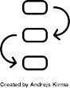

RangeShiftR: three phases of dispersal
Emigration
Leaving the natal site (area where born)
Transfer
Movement through the landscape
Settlement
Establish in a new habitat site /area

Slide 15
RangeShiftR: three phases of dispersal
Emigration
Leaving the natal site (area where born)
Transfer
Settlement

Slide 16
RangeShiftR: three phases of dispersal
Emigration probability:
the probability that an individual will leave its natal patch during the present year
can be density-dependent
Emigration
pEmig
Transfer
N
Settlement

Slide 17
RangeShiftR: three phases of dispersal
Emigration probability:
the probability that an individual will leave its natal patch during the present year
can be density-dependent
Emigration
D0 … saturation value
α … slope at inflection
β … inflection point
pEmig
~α
D0
Transfer
D0/2
β*b
N
Settlement
stage | sex | D0 | α | β
0 | 0 | 0.4 | 10 | 1
0 | 1 | 0.9 | 10 | 1
... | ... | ... | ... | ...
sex = 0 … female
sex = 1 … male

Slide 18
RangeShiftR: three phases of dispersal
Emigration
Transfer
Movement through the landscape
Settlement

Slide 19
RangeShiftR: three phases of dispersal
Phenomenological models
Emigration
e.g. Dispersal Kernel
p
Transfer
distance
Settlement
Mechanistic models
e.g. Movement models:
step-wise processes that take perception and movement costs into account

Slide 20
RangeShiftR: mechanistic movement models
1.) Stochastic Movement Simulator
Movement costs
step-wise process
3
4
1
0
0
1
1
3
3
5
2
3
1
1
4
1
1
0
0
0
5
4
1
0
0
Habitat cell
Matrix cell

Slide 21

RangeShiftR: mechanistic movement models
1.) Stochastic Movement Simulator
Movement costs
step-wise process
takes perception into account
perceptual range (e.g. 1 cell)
3
4
1
0
0
1
1
3
3
5
2
3
1
4
1
1
0
0
0
5
4
1
0
0
Habitat cell
Current cell
Matrix cell
Perceptual area

Slide 22
RangeShiftR: mechanistic movement models
1.) Stochastic Movement Simulator
Movement costs
step-wise process
takes perception into account
perceptual range (e.g. 1 cell)
decision of next direction based on:
lowest average cost
preceeding steps in memory (e.g. 3 steps)
directional persistence
3
4
1
0
0
1
1
3
3
5
2
3
1
4
1
1
0
0
0
5
4
1
0
0
Habitat cell
Current cell
Matrix cell
Perceptual area

Slide 23
RangeShiftR: mechanistic movement models
1.) Stochastic Movement Simulator
Movement costs
step-wise process
takes perception into account
perceptual range (e.g. 1 cell)
decision of next direction based on:
lowest average cost
preceeding steps in memory (e.g. 3 steps)
directional persistence
3
4
1
0
0
1
3
3
5
2
3
3
1
4
1
1
0
0
0
5
4
1
0
0
Habitat cell
Current cell
Matrix cell
Perceptual area

Slide 24
RangeShiftR: mechanistic movement models
2.) Correlated Random Walk
no consideration of costs
step-wise process
considers continuous space, not grid cells
Habitat cell
Matrix cell

Slide 25
RangeShiftR: mechanistic movement models
2.) Correlated Random Walk
no consideration of costs
step-wise process
considers continuous space, not grid cells
draws direction from a distribution:
p
direction
of travel
direction
Habitat cell
Current cell
Matrix cell

Slide 26
RangeShiftR: three phases of dispersal
Emigration
Transfer
Settlement
Establish in a new habitat site /area

Slide 27
RangeShiftR: three phases of dispersal
Emigration
Transfer
Settlement
Settlement probability:
the probability that an individual will stay in a new habitat patch
can be density-dependent (analogous to emigration probability)

Slide 28
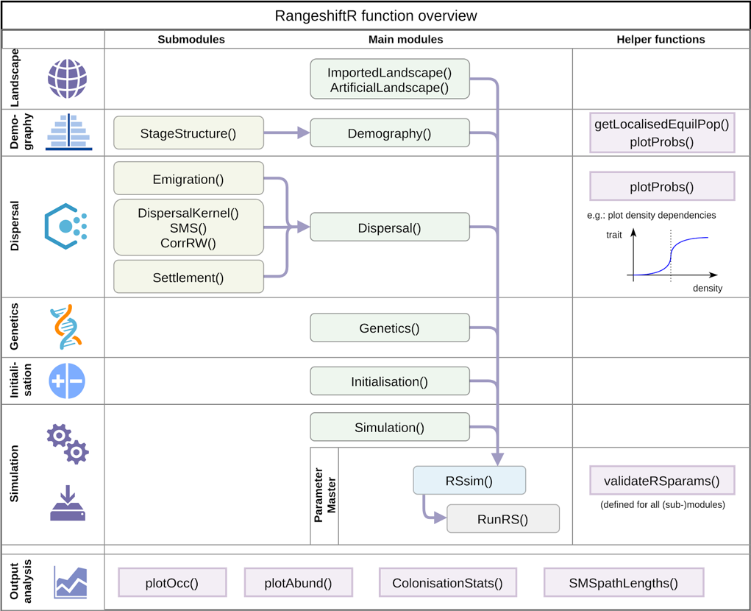


RangeShiftR overview
Malchow et al. (2021) Ecography. DOI: 10.1111/ecog.05689 .
Building on Bocedi et al. (2014) Methods Ecol Evol 5: 388-396. & Bocedi et al. (2021) Ecography. DOI: 10.1111/ecog.05687.
Notes:
Open source
Flexibly to adapt to any species, system, or region
Facilitate model optimisation and comparison,
Integrate model validation and monitoring
Facilitate transparency and collaboration
Enable cost-effective design and evaluation of management solutions
<number>

Slide 29
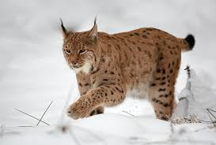
Example: Eurasian lynx, reintroduction Scotland
Break-out rooms of 4-5 participants per group
Time: 45 mins
Script: IBS2022_RS_workshop/code/Prac2_RangeShiftR_Lynx.R
Aberdeenshire
Kintyre Peninsula
Keilder Forest
Ovenden et al. (2019) Biol Cons 234: 140-153.

Slide 30
Break: 15 mins

Slide 31
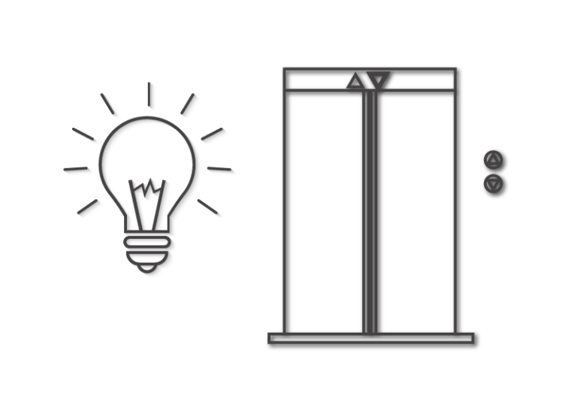
Pitch your project idea!
In break-out rooms of 4-5 participants per group:
Discuss your own research ideas using RangeShifter !
Prepare a 1-min elevator pitch on your Research Concept:
Research question, species, spatial and temporal scale, data sources, …
Time: 20 mins
Afterwards:
Pitch your research idea to the panel !

Slide 32






The RangeShifter project
Thanks for attending our workshop!
The Team:
Our Website:
Greta Bocedi
Steve Palmer
Justin Travis
Greta Bocedi
Steve Palmer
Justin Travis
https://rangeshifter.github.io
https://rangeshifter.github.io
Anne Malchow
Damaris Zurell
Anne Malchow
Damaris Zurell
RangeShifter 2
RangeShiftR

Slide 33
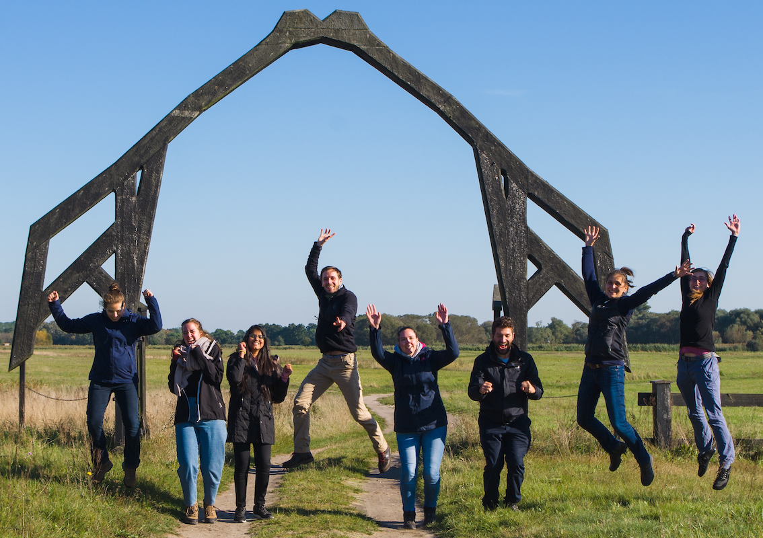

Thank you for your interest
Contact:
Damaris Zurell
Ecology & Macroecology
University of Potsdam
https://damariszurell.github.io
Email: damaris.zurell@uni-potsdam.de
@ZurellLab

